Slide 1
Improving Methods for Analyzing Antimalarial Drug Efficacy Trials: Molecular Correction Based on Length-Polymorphic Markers msp-1, msp-2, and glurp
Sam Jones, Katherine Kay, Eva Maria Hodel, Sophy Chy, Aimable Mbituymuremyi, Aline Uwimana, Didier Ménard , Ingrid Felger , Ian Hastings

Slide 2
Malaria
Endemic in over 100 countries and causes ~400,000 deaths per annum
Prompt treatment is an essential and effective public-health tool but drug resistance poses a constant threat
Drug efficacy trials monitor the continued efficacy of front-line drugs against falciparum malaria
Over-estimates = countries retaining a failing drug as first-line treatment with associated increases in morbidity and mortality
Under-estimates = removal of an effective treatment with substantial practical and economic implications
Trials are challenging
Require long durations of follow-up to detect drug failures
Patients are frequently re-infected during follow up

Slide 3

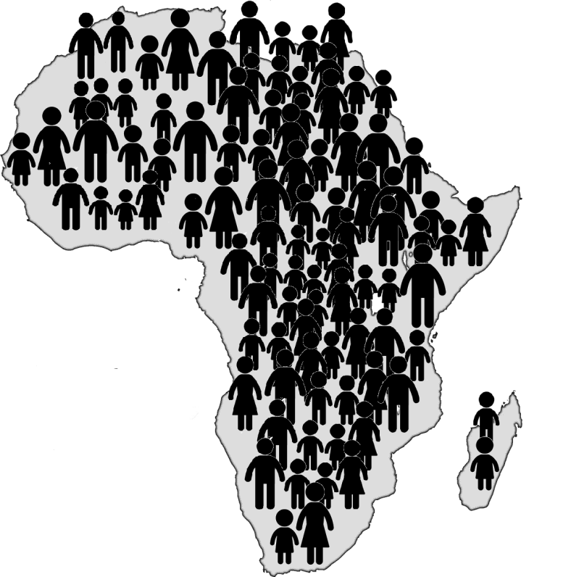
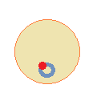
Mechanistic PK-PD model for malaria
Patient PK
Multiple PK models
Repeat
Add variability
Individual treatment outcome
PK/PD model^{1,2}
Parasite PD
% cured
population level
Add variability
Kay, K. and I. M. Hastings (2011). "Development, evaluation, and application of an in silico model for antimalarial drug treatment and failure." Antimicrob Agents Chemother 55(7): 3380-3392

Slide 4
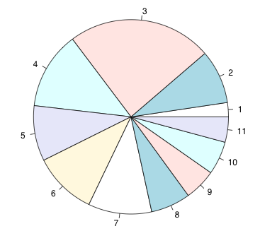
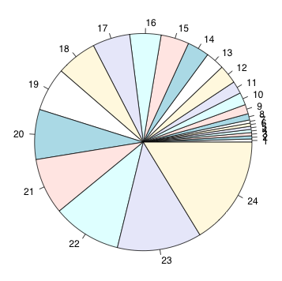
Modifications for clinical trial analysis
Major challenge of efficacy trials
Distinguishing reason for recurrent infection i.e. recrudescent versus new infection
Individual treatment outcome
10¹²
Drug concentration
10¹⁰
Parasite Number
10⁸
Detection limit
Advantage of R
Free, open-source software that is readily available to researchers in developing countries
10⁵
parasites emerging from the liver
% cured
t
Time
Modifications
Multiple clones at the time of treatment
Reinfections emerge from the liver at a rate reflecting local malaria intensity
Parasitemia of each clone was tracked and updated each day to reflect
Extent of drug killing based on the PKPD
Growth rate of each clone
Each clone assigned a genetic profile based on 3 specific molecular markers
Each clone assigned specific alleles for each molecular marker
msp-1
msp2
TA109
TA1
ARA2
GLURP
Schoepflin et al. 2009. Comparison of Plasmodium falciparum allelic frequency distribution in different endemic settings by high-resolution genotyping. Malar J 8:250.
Messerli et al. 2017. Critical evaluation of molecular monitoring in malaria drug efficacy trials and pitfalls of length-polymorphic markers. Antimicrob Agents Chemother 61:e01500 -16.

Slide 5
Clinical trial simulations
PK-PD Model: tracks the genotype of all existing and new malaria clones over time and allows us to determine the true drug failure rate
Reality: not all genetic signals will be observed in every blood sample, detectability varies based on relative frequency, allelic length and family
Simulations: incorporated these problems to generate the genetic signals that would be observed in samples and investigated the predictive capability of four molecular correction algorithms
Jones et al. (2019) Improving Methods for Analyzing Antimalarial Drug Efficacy Trials: Molecular Correction Based on Length-Polymorphic Markers msp-1, msp-2, and glurp. AAC, 63 (9) e00590-19; DOI: 10.1128/AAC.00590-19
Notes:
Jones et al. (2019) Improving Methods for Analyzing Antimalarial Drug Efficacy Trials: Molecular Correction Based on Length-Polymorphic Markers msp-1, msp-2, and glurp. AAC, 63 (9) e00590-19; DOI: 10.1128/AAC.00590-19

Slide 6
Results – comparing algorithms
WHO method
No glurp
Patient classified as
Recrudescence
Reinfection
WHO algorithm correctly classifies nearly all reinfections, but misclassifies around one-third of recrudescences
No-glurp algorithm is similar to the WHO algorithm
>= 2/3 markers algorithm had fewer misclassifications and was also more balanced
Allelic family switch algorithm correctly classifies a large proportion of recrudescences but misclassifies a large number of reinfections.
Number of patients
Recrudescence Reinfection
Recrudescence Reinfection
>= 2/3 markers
Allelic family switch
Recrudescence Reinfection
Recrudescence Reinfection
True status on day of recurrence
Jones et al. (2019) Improving Methods for Analyzing Antimalarial Drug Efficacy Trials: Molecular Correction Based on Length-Polymorphic Markers msp-1, msp-2, and glurp. AAC, 63 (9) e00590-19; DOI: 10.1128/AAC.00590-19

Slide 7
Results – re-analysis of clinical trial data
Country | Drug | Molecular assignment | Number of infections classified by algorithm
 |  |  | WHO | No glurp | ≥ 2/3 markers | Allelic family switch
Rwanda | Artemether - Lumefantrine | Recrudescence | 17 | 27 | 36 | 59
 |  | New infections | 93 | 83 | 73 | 51
 | DHA - Piperquine | Recrudescence | 3 | 6 | 8 | 18
 |  | New infections | 40 | 37 | 35 | 25
Model predictions using the WHO method were highly consistent with existing in vivo data
Predictions with the newly proposed “≥ 2/3 markers” algorithm suggest the WHO-method under-estimates true treatment failure rates
Jones et al. (2019) Improving Methods for Analyzing Antimalarial Drug Efficacy Trials: Molecular Correction Based on Length-Polymorphic Markers msp-1, msp-2, and glurp. AAC, 63 (9) e00590-19; DOI: 10.1128/AAC.00590-19

Slide 8
Summary
Model was applied to multiple drugs across a range of transmission settings and was able to quantify the accuracy of failure rate estimates in therapeutic efficacy studies
Accurately predicting failure estimates is clinically important
Molecular correction is essential to avoid substantial over-estimates of failure rates.
Current WHO-recommended algorithm consistently under-estimates the true failure rate.
A newly-proposed algorithm (“≥ 2/3 markers”) produces accurate failure rate estimates, robust at all levels of transmission intensity.
Long durations of patient follow-up may be counterproductive; large numbers of new infections accumulate and may be misclassified, over-estimating drug failure rate.
Jones et al. (2019) Improving Methods for Analyzing Antimalarial Drug Efficacy Trials: Molecular Correction Based on Length-Polymorphic Markers msp-1, msp-2, and glurp. AAC, 63 (9) e00590-19; DOI: 10.1128/AAC.00590-19

Slide 9
Summary
Implemented in R - mainly base R, with dplyr, ggplot, survival and survminer packages for calculating drug efficacy
Open source software particularly attractive for tropical diseases as they typically occur in countries with limited resources and paying for licenses can be an unnecessary barrier to progress
Future
Developing a Bayesian algorithm to more accurately predict failure rates
Developing an R package that could be used to process user sample data and return failure rate estimates based on all the algorithms

Slide 10
Acknowledgements
Liverpool School of Tropical Medicine
Sam Jones
Ian Hastings
Eva Maria Hodel
Institut Pasteur
Didier Ménard
Swiss Tropical and Public Health Institute
Ingrid Felger
Institut Pasteur in Cambodia
Sophy Chy
Rwanda Biomedical Center
Aimable Mbituymuremyi
Aline Uwimana
Grant: 1032350
Grant: G1100522
& MR/L022508/1
Grant: UWSC9757

Slide 12
Analysis of genetic data
Simulated the genotyping that would be used in vivo to recover the genetic signal observed by light microscopy at the time of treatment and at predetermined days during the follow-up period.
Technical limitations of acquiring blood samples and genotyping
A “sampling limit” exists; a finite amount of blood is used for genotyping
Magnitude of the genetic signal produced by an allele was proportional to the number of parasites carrying in the allele
An inherent feature of PCR is “template competition”
i.e., the relative detectability of alleles at each marker is dependent on their length, with shorter alleles being more detectable due to their being better amplified in the PCR process
The shortest allele in each case was assumed to have a relative detectability of 1, while the longest had a relative detectability of 0.001

Slide 13
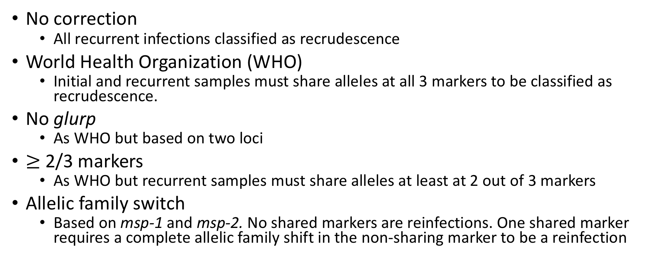
Molecular correction algorithms
No correction
All recurrent infections classified as recrudescence
World Health Organization (WHO)
Initial and recurrent samples must share alleles at all 3 markers to be classified as recrudescence.
No glurp
As WHO but based on two loci
$≥$ 2/3 markers
As WHO but recurrent samples must share alleles at least at 2 out of 3 markers
Allelic family switch
Based on msp-1 and msp-2. No shared markers are reinfections. One shared marker requires a complete allelic family shift in the non-sharing marker to be a reinfection

Slide 14
Malaria parasite dynamics following treatment of a hypothetical patient
Key features of a “typical” infection
Declining drug concentration post treatment (blue line)
Parasite clones detectable at the time of treatment (green and red lines)
New clones with potential to cause re-infection (Gray and orange lines)
Major challenge of efficacy trials
Distinguishing reason for recurrent infection i.e. recrudescent versus new infection
0 3 7 14 21 28 35 42 49 56 63
Time post-treatment (days)

